Slide 1

CS1010: Programming Methodology Lecture 2: Overview of C Programming

Slide 2
Week 2: Overview of C Programming
Objectives
Able to write, compile and run a program.
Understand basic C constructs, interactive input, output, and arithmetic operations.
Understand basic programming style.
Understand various categories of programming errors.
Week2 - 2

Slide 3
Week 1 Lecture Review
Problem solving steps:
Determine problem features
Analysis
Design algorithm
Design
Rethink as appropriate
Write code
Implementation
Check for correctness (and efficiency)
Testing
* algorithm is a set of carefully designed steps, describing how to solve a task / sub-task
Week2 - 3
Notes:
The key idea is: you need to verify the correctness of algorithm before turning it into code. The worse case is that you finished typing code, but sad to find that your idea is completely wrong.

Slide 4
Revisit Our First Program (1/6)
Given a distance in miles, convert it to kilometers.
kilometer = mile * 1.609
Algorithm:
1. read distance in unit miles
2. convert the distance to kilometers
3. print the distance in kilometers
Once the algorithm is ready, you may take each step and translate them into C, C++, Java, Ruby, Prolog… whatever, program.
Week2 - 4

Slide 5
Revisit Our First Program (2/6)
// converts distance from miles to kilometers
#include <stdio.h> // enable data input, output
#define KMS_PER_MILE 1.609 // define constant
int main(void)
{
float miles, // input - distance in miles
kms; // output - distance in kilometers
printf("Enter the distance in miles> ");
scanf("%f", &miles); // 1. read distance in miles
kms = KMS_PER_MILE * miles; // 2. convert to km
/* 3. print the distance in kilometers */
printf("That equals %9.2f kilometers.\n", kms);
return 0;
}
Enter the distance in miles> 15
That equals 24.14 kilometers.
Week2 - 5

Slide 6
Revisit Our First Program (3/6)
Basic C program structure:
preprocessor directives followed by the main function
preprocessor directives
int main(void)
{
variable declarations
executable statements
}
Week2 - 6
Notes:
Next week we will see examples of more than 1 function

Slide 7
Revisit Our First Program (4/6)
preprocessor directives
// converts distance in miles to kilometers
#include <stdio.h>
#define KMS_PER_MILE 1.609
int main(void)
{
float miles, // input - distance in miles
kms; // output - distance in kilometers
printf("Enter the distance in miles> ");
scanf("%f", &miles);
kms = KMS_PER_MILE * miles;
printf("That equals %9.2f kilometers.\n", kms);
return 0;
}
standard header file
Variables used:
constant
variables
miles
kms
main function
predefined functions
Week2 - 7
Notes:
Every variable corresponds to a memory slot (allocated by the system automatically). Assigning values to a variable means store data in that memory slot.
'printf' enables us to print out message on screen; 'scanf' enable us to read data from keyboard input.
'return' means return to the caller. The caller of 'main' function is OS. Return value 0 has some means for OS, but is not in the scope of CS1010.

Slide 8
Revisit Our First Program (5/6)
// converts distance in miles to kilometers
#include <stdio.h>
#define KMS_PER_MILE 1.609
int main(void)
{
float miles, // input - distance in miles
kms; // output - distance in kilometers
printf("Enter the distance in miles> ");
scanf("%f", &miles);
kms = KMS_PER_MILE * miles;
printf("That equals %9.2f kilometers.\n", kms);
return 0;
}
comments
reserved words
format specifier
String constant
multiplication
assignment
semicolon
Enter the distance in miles> 15
That equals 24.14 kilometers.
Week2 - 8
Notes:
Comments will be ignored by computer, and therefore you may write anything inside it without following C syntax.
Writing comments is a good habit to help others understand your program.
Semicolon indicate the end of a statement; each statement is an instruction telling a computer something to do (input/output, calculation…).

Slide 9
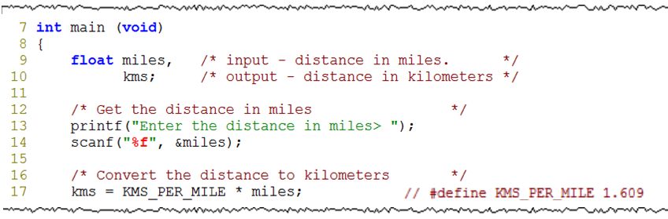
Revisit Our First Program (6/6)
uninitialized variables contain garbage values!
memory
memory
memory
machine language Week1_MileToKm conversion program
machine language Week1_MileToKm conversion program
machine language Week1_MileToKm conversion program
miles
miles
miles
?
10.5
10.5
kms
kms
kms
?
?
16.8945
Week2 - 9
Notes:
An uninitialized variable contains garbage value, not necessarily zero! (Very common mistake.)

Slide 10
Writing C Programs in UNIX (1/5)
Source code
Editor
produces
welcome.c
eg: vim welcome.c
Executable code
Compiler
produces
a.out
Cannot compile?
eg: gcc –Wall welcome.c
Output
Execution
produces
Incorrect result?
Welcome to week 2 lecture!
eg: a.out
Week2 - 10
Notes:
Your source code is written in C language. C language is a high-level programming language. So the source code cannot be understood by OS directly. You need to turn it into a machine code using a compiler.

Slide 11
Writing C Programs in UNIX (2/5)
To write a program called “Week1_MileToKm.c”:
If this file doesn’t exist on hard disk, a new file will be created.
If this file already exist, will open it for your editing.
Vim is a text editor:
Default mode: command mode.
Switch between insert and command modes: i, <Esc>
:wq to save and quit vim.
$ vim Week1_MileToKm.c
Week2 - 11
Notes:
There are other editors available in UNIX, such as vi, pico and nano.
An editor is a tool for you to type in characters. In Windows, we use editors such as Notepad and WordPad.

Slide 12
Writing C Programs in UNIX (3/5)
To compile “Week1_MileToKm.c”:
If your program contains syntax errors, gcc will report them to you.
If no syntax error is found, a default file “a.out” will be created in the same directory.
“a.out” is an executable version of your source code.
-Wall reminds gcc to tell you all warning messages (if any). A warning message targets at a susceptible error in your program.
$ gcc –Wall Week1_MileToKm.c
Week2 - 12

Slide 13
Writing C Programs in UNIX (4/5)
Some other compilation options:
Output file will be named as MileToKm as you instructed.
Output file will be named as abc.exe as you instructed.
Compiler won’t warn you any susceptible error anymore!
$ gcc –Wall Week1_MileToKm.c –o MileToKm
$ gcc –Wall Week1_MileToKm.c –o abc.exe
$ gcc Week1_MileToKm.c
Week2 - 13

Slide 14
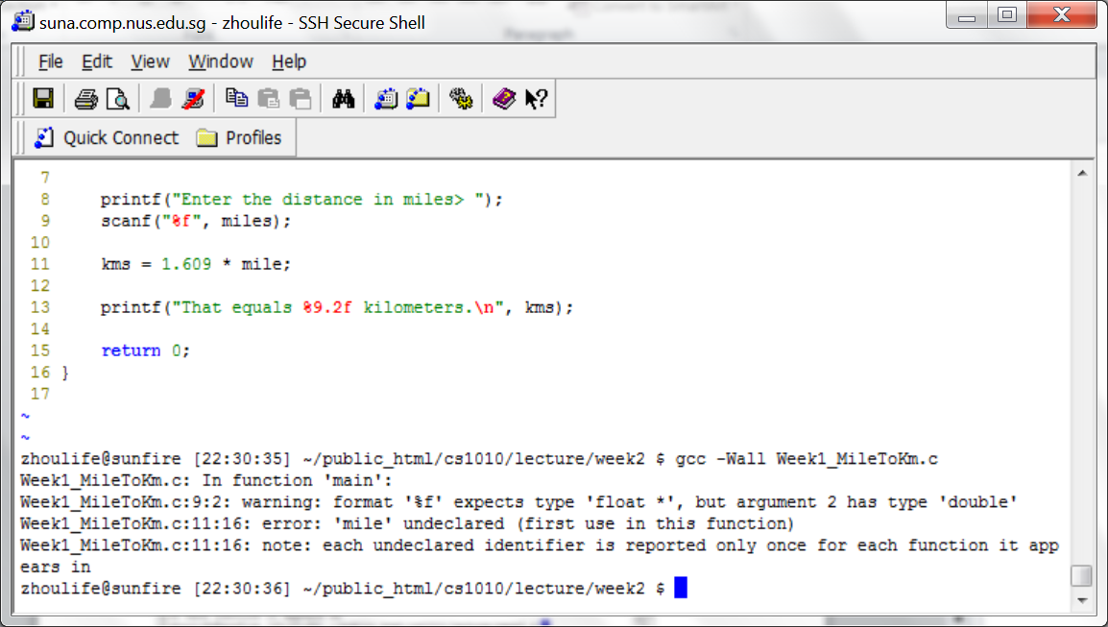
Writing C Programs in UNIX (5/5)
When there are compilation errors…

Slide 15
Errors: Taxonomy
Syntax Error (and warning)
Program does not obey C grammar such as invalid choice of identifier name, invalid expression, missing semi-colon, etc.
Warning happens, for example, due to incomparable use of types for output
Run-time Error
Program terminates unexpectedly due to illegal operation, such as dividing a number by zero
Logic Error
Program produces result as opposed to what is expected (wrong algorithm)
The process of correcting errors in programs is called debugging.
Debugging can be very time-consuming.
Week2 - 15

Slide 16
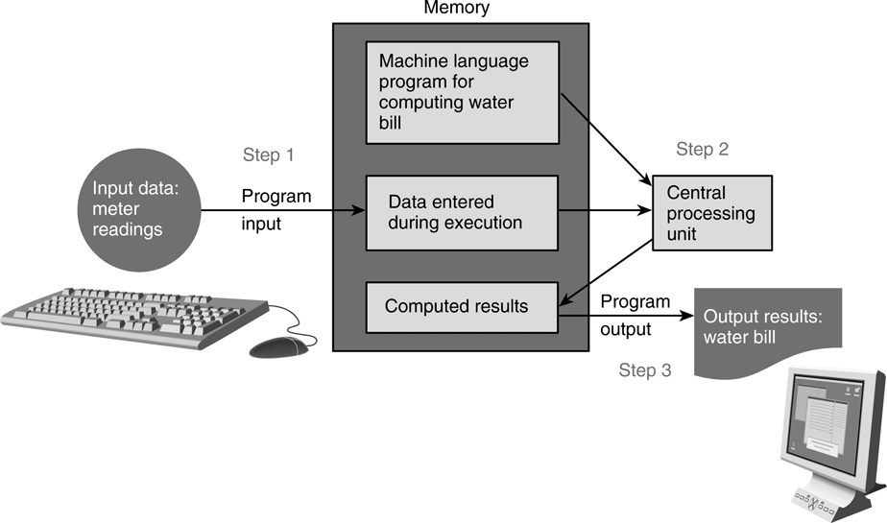
Understanding Program Structure
In general, a C program has 3 logical parts:
Data input from keyboard (using scanf) or from file
Compute through arithmetic / logic operations
Data output to screen (using printf) or to file
The keyboard and screen are known as standard input (stdin) and standard output (stdout).
Notes:
In C language, scanf is used to read data from standard input channel (keyboard); printf is used to print out data to standard output channel (monitor).

Slide 17
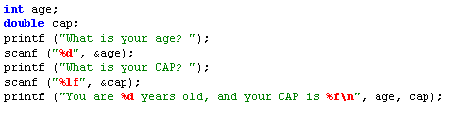

Program Structure: Input/Output (1/3)
Input/output statements:
printf (string constant);
printf (format string, print list);
scanf (format string, input list);
age
One version:
“age” refers to value in the variable age.
“&age” refers to (address of) the memory cell corresponds to the variable age.
Another version:
Week2 - 17
Notes:
Side notes: address of variable "age" varies each time a program is run.

Slide 18
Program Structure: Input/Output (2/3)
%d, %f, %lf etc. are placeholder (a.k.a format specifier)
Placeholder | Variable Type | Function Use
%c | char | scanf / printf
%d | int | scanf / printf
%f | float | scanf
%lf | double | scanf
%f | float or double | printf
%e | float or double | printf (for scientific notation)
More complex use in printf (not in scanf!)
%5d is to print an integer with width of 5
%8.2f is to print a real number in a total width of 8, with 2 decimal places
%.3f is to print a real number with 3 decimal places
Week2 - 18

Slide 19
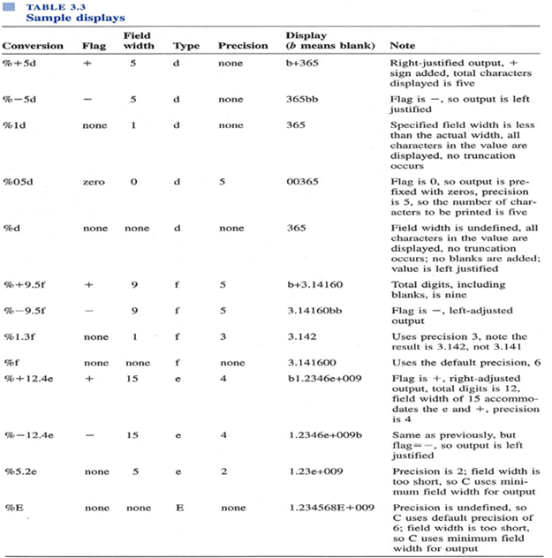

Slide 20
Program Structure: Input/Output (3/3)
\n is called newline character
An example of escape sequence (more in the table below)
Used in printf to change line.
Escape sequence | Meaning | Result
\n | New line | Subsequent output will appear on the next line
\t | Horizontal tab | Move to the next tab position on the current line
\" | Double quote | Display a double quote "
%% | Percent | Display a percent character %
For your lab programs submitted to CodeCrunch, make sure your last line of output ends with \n, or your program might fail correctness tests.
Week2 - 20
Notes:
Demo using Week1_MileToKm.c:
with / with out '\n'
open two SSH windows
Use <tab> for auto-completion

Slide 21
Program Structure: Compute (1/9)
Computation is done inside function(s)
int main (void)
is a special function where execution of a program starts.
A function body has two major parts:
declarations: tell compiler what type of memory cells needed
executable: describe the processing on the memory cells
int main(void)
{
declaration statements
executable statements
return 0;
}
Week2 - 21
Notes:
For the int main(void) function, theoretically we can return any integer value, but we usually return 0 because the exit code 0 usually means a successful run (esp. when run in UNIX environment).
We can have the function return different values on different conditions (eg. in an 'if' statement) to indicate under what circumstance did the program end.
Exit code is useful if we need to check the termination status of a program after the program is run (for some follow-up action), though we don’t make use of it in this course.

Slide 22

Program Structure: Compute (2/9)
Declaration Statements
Part 1: Standard Data Types
data type: tells computer how to store a particular value in memory and what operations can be performed on the value.
int
32 bits, hence value between -2,147,483,648 (-2³¹) through +2,147,483,647 (2³¹ – 1)
float (and also double)
an abstraction for real numbers
3.14159
15.0e-4 or 15.0E-4 (value is 0.0015)
char
a character, which is a letter, a digit, or a special symbol
'A' 'z' '2' '9' '*' '?' ' '
Week2 - 22
Notes:
Date type decides how data is stored in computer, as an integer or a real number? If is a real number, is it encoded in double or float?

Slide 23
Program Structure: Compute (3/9)
Declaration Statements
Part 2: Identifier
Reserved words (or keywords)
e.g., int, void, double, return
Standard identifier
e.g., printf, scanf
User-defined identifier
avoid reserved words and standard identifiers
consist only of letters, digits and underscores
must not begin with a digit
case-sensitive
e.g., invalid: 1Letter, double, int, TWO*FOUR, joe’s
valid: maxEntries, _X1234, this_IS_a_long_name
Week2 - 23

Slide 24
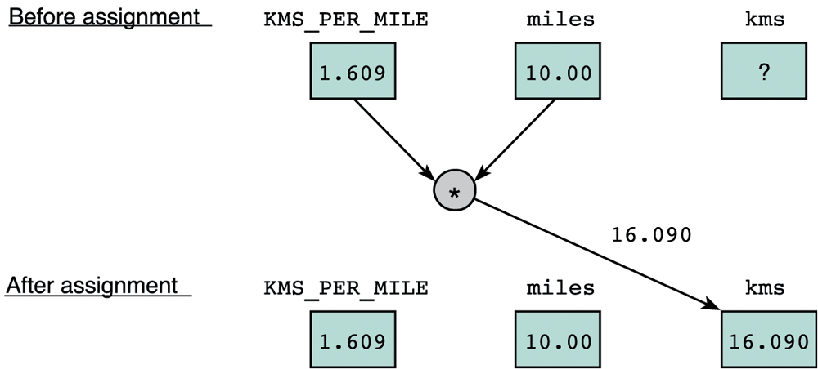
Program Structure: Compute (4/9)
Executable Statements
I/O statements (e.g. printf, scanf)
Assignment statements
stores a value or a computational result in a variable
e.g., kms = KMS_PER_MILE * miles;
= is not equality, but assignment
Week2 - 24
Notes:
Executable statements are the instructions where we process data.

Slide 25
Program Structure: Compute (5/9)
Executable Statements
I/O statements (e.g. printf, scanf)
Assignment statements
stores a value or a computational result in a variable
e.g., kms = KMS_PER_MILE * miles;
Note: left hand side of an assignment statement is called lvalue – it must be assignable
e.g., 32 = a;
a + b = c;
Assignment can be cascaded, with associativity from right to left:
e.g., a = b = c = 3 + 6;
means: c = 3 + 6; b = c; a = b;
Compilation error:
lvalue required as left operand of assignment
Week2 - 25

Slide 26
Program Structure: Compute (6/9)
Arithmetic operations
Unary operators: +, –
int y = -4; int x = -y;
Binary operators: +, –, *, /, % (modulo or remainder)
Left Associative (from left to right)
45 / 15 / 3 → 3 / 3 → 1
19 % 7 % 3 → 5 % 3 → 2
4 + 3 * 5 →
(4 + 3) * 5 →
Execute from left to right, respecting parentheses rule, and then precedence rule, and then associative rule (next page)
+, – are lower in precedence than *, /, %
= is lower in precedence than arithmetic operations.
19
35
Week2 - 26

Slide 27
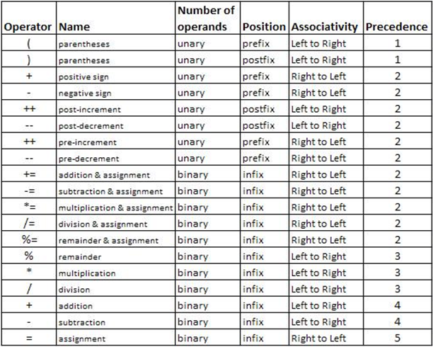
Program Structure: Compute (7/9)
Arithmetic operators: Associativity & Precedence
Week2 - 27

Slide 28
Program Structure: Compute (8/9)
Some interesting rules on arithmetic operations
Integer division
If both operands are integers, then the result of their division is also an integer.
5 / 2
Truncated result if result can’t be stored
int n; n = 9 * 0.5;
Data type promotion in mixed-type operation
If an operation is specified between a low precision data type and a high precision data type, the result of calculation would of high precision data type.
2 * 2.0
2
4 will be stored in n.
4.0
Week2 - 28
Notes:
Integer division and truncation can sometimes produce unexpected results, because any decimal portion of the integer division is dropped.

Slide 29
Last week’s Example
Compute the average of three input integers.
// Computes the average of 3 integers from user input
#include <stdio.h> // enable data input, output facilities
int main(void)
{
int num1, num2, num3; // declare necessary variables
float ave;
printf("Enter 3 integers: "); // prompt for user input
scanf("%d %d %d", &num1, &num2, &num3); // read 3 user inputs
ave = (num1 + num2 + num3) / 3;
printf("Average = %.2f\n", ave); // print out result
return 0;
}
Enter 3 integers: 5 9 -3
Average = 3.00
Week2 - 29

Slide 30
Program Structure: Compute (9/9)
Mixed-Type Arithmetic Operations
int m = 10/4; means
float p = 10/4; means
float q = 10/4.0; means
int n = 10/4.0; means
Type Casting
Use a cast operator to change the type of an expression
syntax: (type) expression
int aa = 6; float ff = 15.8;
float pp = (float) aa / 4; means
float qq = (float) (aa / 4); means
int nn = (int) ff / aa; means
Week2 - 30
Notes:
Abbreviated assignment and increment operator will be introduced in next week’s discussion session.

Slide 31
Demo #1 Fahrenheit to Celsius (1/2)
We are to write a program to convert a temperature in degrees Fahrenheit to degrees Celsius
Celsius = 5 / 9 * (Fahrenheit – 32)
We use the vim editor to write program Week2_FtoC.c
We then compile the program with gcc.
We execute the program and is supposed to observe the following sample runs:
Enter temperature in Fahrenheit: 32.5
That equals 0.277778 Celsius.
Enter temperature in Fahrenheit: 0
That equals -17.777778 Celsius.
Week2 - 31

Slide 32
Demo #1 Fahrenheit to Celsius (2/2)
/* convert temperature from Fahrenheit to Celsius */
#include <stdio.h>
int main(void)
{
double celsius, fahrenheit;
printf("Enter temperature in Fahrenheit: ");
scanf("%lf", &fahrenheit);
celsius = 5.0 / 9 * (fahrenheit - 32);
printf("That equals %lf Celsius\n", celsius);
return 0;
}
// celsius = 5 / 9.0 * (fahrenheit - 32);
// celsius = (fahrenheit - 32) * 5 / 9;
Week2_FtoC.c
Week2 - 32
Notes:
Here listed three common ways to bypass integer division.

Slide 33
Coding Style
Identifier naming for variables and functions
User-defined identifiers: use lower-case (with underscore if necessary)
User-defined constants: use all upper-cases
Use names that are descriptive, meaningful
Consistent indentation, and spacing to emphasize block structure
int main (void)
{
statements
}
Comment major code segments or complex logic:
// one line comment
/* block comment */
Header comment: your name, NUSNET id, program’s purpose, etc.
Week2 - 33
Notes:
Demo gg=G using Week2_FtoC.c
In lab assignments, marks will be deducted for bad style (bad naming of variables, poor indentation, no name and program description, etc.)
Internet resource on coding style: http://www.cs.swarthmore.edu/~newhall/unixhelp/c_codestyle.html

Slide 34
Ex #1: Temperature Estimate (1/3)
Write a program Week2_Freezer.c that estimates the temperature in a freezer (in ºC) given the elapsed time (hours) since a power failure. Assume this temperature (T) is given by:
where t is the time (in unit hour) since the power failure.
Your program should prompt the user to enter how long it has been since the start of the power failure in hours and minutes, both values in integers.
Note that you need to convert the elapsed time into hours in real number (use type float).
For example, if the user entered 2 30 (2 hours 30 minutes), you need to convert it to 2.5 hours before applying the above formula.
Week2 - 34

Slide 35
Ex #1: Temperature Estimate (2/3)
Download the skeleton program:
Refer to the sample runs below. Follow the input / output format.
* This exercise is mounted on CodeCrunch as a practice exercise.
cp ~cs1010/lecture/Week2_Freezer.c .
Enter hours and minutes since power failure: 2 45
Temperature in freezer = -13.63
Enter hours and minutes since power failure: 1 0
Temperature in freezer = -18.67
Week2 - 35

Slide 36
Ex #1: Temperature Estimate (3/3)
Week2_Freezer.c
// Estimates the temperature in a freezer (in C)
// given the elapsed time (hours) since a power failure.
#include <stdio.h>
int main(void)
{
int hours, minutes;
float time, temperature;
printf("Enter hours and minutes since power failure: ");
scanf("%d %d", &hours, &minutes);
time = hours + minutes/60.0; // convert hour & minutes to hours
temperature = 4 * time * time / (time + 2) - 20;
printf("Temperature in freezer = %.2f\n", temperature);
return 0;
}
Week2 - 36

Slide 37

Summary for Today
Today’s most important lessons
Using vim to write a program and gcc to compile it
Program structure
Data input using scanf
Data compute: variable, data type, precedence rules, integer division, truncation, typecast
Data output using printf
Coding style: naming, presentation, simplicity and efficiency.
Errors: syntax, run-time and logic error.
Week2 - 37

Slide 38
End of File

